Slide 1

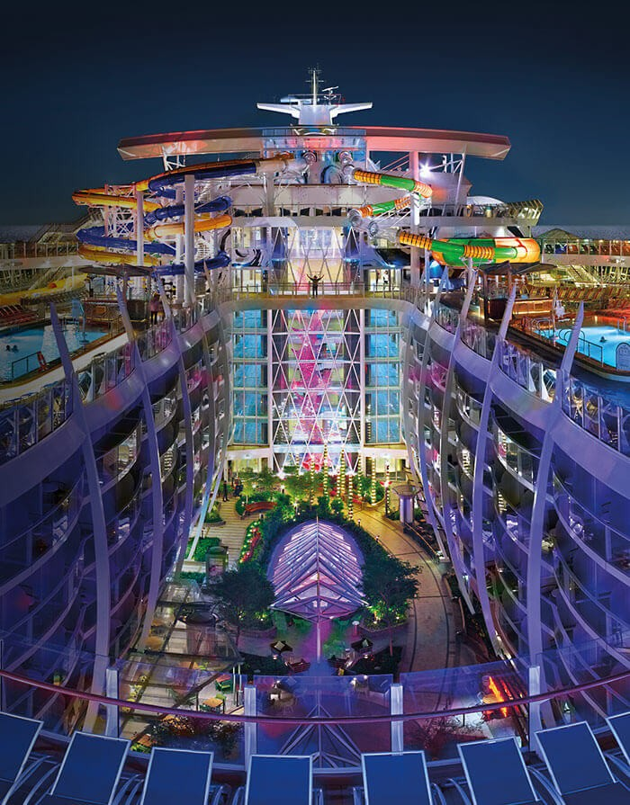
Leveraging Targeted Marketing to Deliver Sustained Growth
ADVENTURE WITH A SMILE
By: Royal Caribbean Analytics Center of Excellence
Team Members: Venkat Gopalakrishnan, Justin Kroenert, Ashish Mahadik, Dan Olmsted, Sammazo Plamin, Anupriya Thirumurthy
Prepared For: Roger Moore , CFO
August 25, 2018

Slide 2
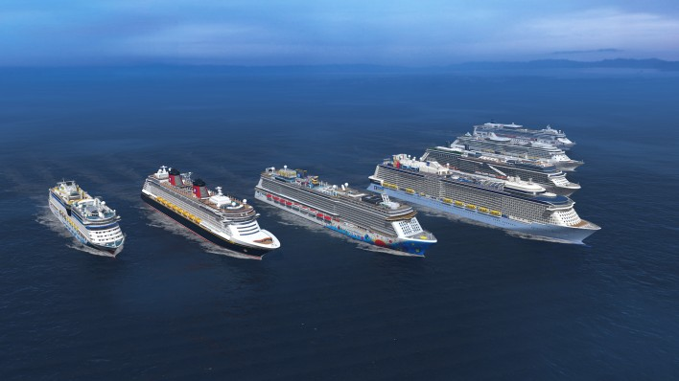
Agenda
Industry & Company Background
Analytical Opportunities
Business Case

Slide 3
Executive Summary
Bookings are at an all-time high
Costs have been well managed
Guest satisfaction has improved significantly
To help achieve our long-term 20/20 strategic vision we identified five key analytical opportunities
Millennials represent the fastest growing consumer segment
Engaging Millennials through targeted marketing will result in $3.1M NPV over 4 years

Slide 4
Global Cruise Industry Poised To Break More Records
Opportunity
Business Case
Background
Demand for cruising has increased 20.5% in the past five years
Fastest growing category in the leisure travel market
25.8 million passengers cruised globally in 2017
Generated $35.5 billion revenue in 2016
Almost all levels of income enjoy cruise vacations

Slide 5

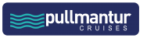
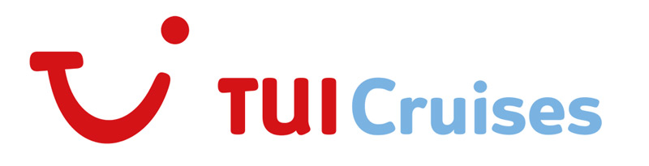

Strength And Diversity Of Brands And Itineraries
Background
Opportunity
Business Case
Operate a combined total of 50 ships
Aggregate capacity of 123,270 berths as of Dec. 31, 2016
540 destinations in 105 countries

Slide 6
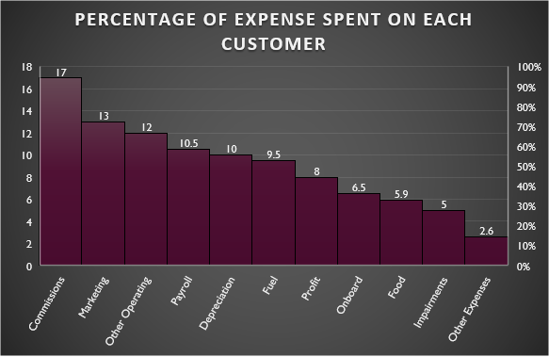
Financial Reports Of Royal Caribbean Shows Only A Small Portion Of The Revenue Per Passenger Becomes Profit
Background
Opportunity
Business Case
Example Year – 2015
Total 5.4 million passenger spent $8.4 billion
In other words, for every passenger Royal Caribbean carried, they spent $1,536
Of that $1,536, 73% ($1,121 per passenger) was spent on cruise fares
$415 per passenger was spent on board for everything from booze to t-shirts in the gift shop.
Of the $1,536 in revenue generated from each passenger, only 8% — $123 — ends up as profit.
Source: https://www.cruzely.com/heres-how-much-money-cruise-ships-make-off-every-passenger-infographic/

Slide 7
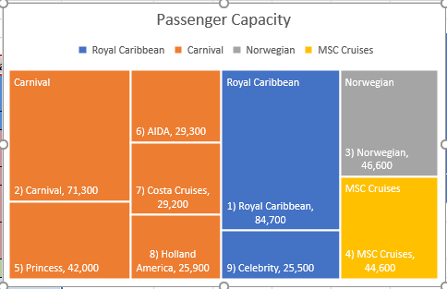
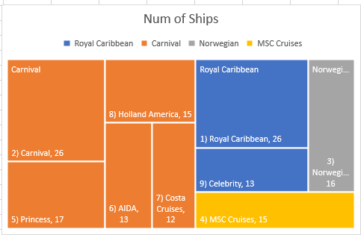
As One Single Entity Royal Caribbean Stands Massive While Carnival Is Huge With Lot Of Brands.
Background
Opportunity
Business Case
The cruise industry is characterized by three large public companies (Carnival, Royal Caribbean, and Norwegian), one large privately held company (MSC Cruises), and a host of smaller competitors.
Due to the size, scale, and experience of the ships, the larger cruise lines listed here are Royal Caribbean Cruise Lines(RCCL) main competitors
Most of these cruise lines compete directly with RCCL for an upper casual to premium vacation experience.
The exception would be Carnival, which brands itself “The Fun Ships” and caters to a younger, less sophisticated clientele
Source: https://www.statista.com/statistics/269134/passenger-capacity-of-the-cruise-industry-worldwide-by-cruise-line/

Slide 8
Opportunity
Business Case
Background
Driver Tree Reveals Five Opportunities
Profit
Increase Revenue
Predictive Maintenance
Decrease Cost
Predict Likelihood of Returning Customers
Customer Segmentation
Targeted Advertisement
Energy Efficient Ships

Slide 9
Targeted Advertisement Wins Across All Three Evaluation Criteria
Opportunity
Business Case
Background
Opportunity | Profit Potential | Ease of Obtaining Data | Ease of Implementation | Average Score
Recurring Customers | 3 | 2 | 3 | 2.67
Customer Segmentation | 4 | 3 | 4 | 3.67
Targeted Advertisement | 4 | 4 | 4 | 4
Predictive Maintenance | 4 | 1 | 2 | 2.33
Energy Efficient Ships | 3 | 2 | 1 | 2
1 = least impactful
5 = most impactful
Source – Reading packet 4 – Leadership class

Slide 10
Attract New Customers And Increase Recurring Customer Rate
Opportunity
Business Case
Background
Business Problem
Analytical Solution
Impact
Low Recurring Rate
Increase retention rate and trip frequency
One time customer
Advertising the wrong area of the product
The customers want to explore competitors
Identify key factors for why customers come back
Develop promotional package to target at risk (one time) customers and prospective customers
Improve customer satisfaction by knowing what matters
Opportunity to increase brand value satisfaction
Predict customer likelihood to come back

Slide 11
Better Customer Insights by Segmentation
Opportunity
Business Case
Background
Business Problem
Analytical Solution
Establish customer data collection process
Develop clustering algorithm
Derive patterns from output clusters
Impact
Communication strategies that resonate with target audiences
Divide market into workable customer segments
Better understanding of consumer data
Perform consumer assessment
Develop Customer Insights
Improve Customer Engagement
Improve Brand loyalty
Create popular service packages
Target high value customers
Use untraditional customer behavior characteristics

Slide 12
Opportunity
Business Case
Background
Targeted Advertising Can Tap Into Underserved Markets & Grow Revenue
Business Problem
The cruise industry has not been attracting younger vacationers as seen by a rising average customer age
An older and shrinking clientele could someday be devastating given the large fixed costs of owning an ocean cruise vessel
Analytical Solution
Use targeted advertising on travel blogs and travel websites targeting this demographic
Customize the ads to various subgroups, highlighting their likely preferences in a vacation
Impact
Tapping into a large potential market has immediate revenue benefits
With a good first experience, this younger generation may take many cruises over their longer lifetimes
Being more active on social media, satisfied Millennials could be great ambassadors for our brand

Slide 13

Implementation Will Require 11 Resources In 11 Months
Opportunity
Business Case
Background
Benefits of targeted marketing
More Cost effective than traditional marketing campaigns
Number of Resources Needed
3 Full Time Employees (2 for model development and 1 Manager)
8 Consultants (2 per Requirement Gathering, Data Engineering, Testing phase 1 and phase 2)
Implementation and Go live Schedule
11 months (August 2018 – June 2019)

Slide 14
Project Implementation Timeline Spans 11 Months
Opportunity
Business Case
Background
Requirement Analysis (Aug 2018 – Sep 2018)
Model Dev & Testing – Iteration 2 (April 2019 – May 2019)
Model Development (Dec 2018 – Jan 2019)
Model Testing (Feb 2019 – Mar 2019)
Data Engineering (Oct 2018 – Nov 2018)
Model Implementation (June 2019)

Slide 15
Targeted Advertising Project Risks will be Offset by Mitigating Factors, Making them Manageable
Opportunity
Business Case
Background
Risks | Mitigation
Legal & Reputational Risk Strict government regulations about data privacy (EU GDPR) Many consumers value privacy and may not do business with firms viewed as being intrusive | Follow the law, be transparent regarding data usage with customers Use a reputable data provider
Data Quality Risk Poor data quality yields a poor model and will decrease the model success rate | Partner with a trustworthy data vendor
Customer Risk Customers avoid and/or ignore ads. They want the actual page content. Ads may be overshadowed by other advertisements on the same page | An attractive, tasteful, and age sensitive ad can effective draw customer attention Ads will be tastefully designed to account for competing ads
Operational Risk Ads must be compatible across all viewing platforms. Non-compatible devices and software/browser complications can reduce the customer click ratio. | Hire a third party software consultant which can help create light weight ads which will work across multiple software and hardware combinations

Slide 16
Financials: Baseline NPV Analysis Reveals The Project To Be Profitable And Attractive
Opportunity
Business Case
Background
Baseline NPV is driven by experiences of past digital ad campaigns and estimates of vendor/provider costs – a positive $3.1 million meets our corporate goals

Slide 17
Financials: Adverse NPV Analysis Reveals The Project To Still Be Modestly Profitable
Opportunity
Business Case
Background
Worst case NPV is driven by higher costs across the board and lower revenues – yet still yields a positive NPV of $0.6 million

Slide 18
Marketing To Millennials Offers The Greatest Financial Benefits With Minimal Risk
Opportunity
Business Case
Background
Evolving our marketing strategies to specifically target a new generation of passengers will grow our business in the long term and allow us to remain competitive
Targeted marketing is more effective than traditional mass marketing campaigns and will generate $3.1M NPV over 4 years
Targeted marketing is more efficient because it will not waste money advertising to people outside the targeted segment.
Targeted advertising will yield tangible benefits and are an efficient use of our advertising budget. The time to act is now!
Anticipated implementation schedule is 11 months
Resources needed: 9 FTEs

Slide 19
Analytical Opportunity
Evaluation
Conclusion
Appendix
Driver Tree
Appendix - 1 (Sources)
http://www.rclcorporate.com/rcl-steps-to-the-fore-with-plans-for-fuel-cell-technology/
https://www.greenbiz.com/blog/2014/10/06/carnival-cruises-towards-25-billion-fuel-savings
https://www.veristar.com/portal/rest/jcr/repository/collaboration/sites/veristarinfo/web%20contents/bv-content/generalinfo/publications/bulletintechnique/BT_2012/Ship_12/modelling/documents/5464.2.Marty-IMDC2012.pdf
https://www.sciencedirect.com/science/article/pii/S2405896317314362

Slide 20
Appendix - 2 (Sources)
http://www.rclcorporate.com
https://www.cruiseindustrynews.com
http://www.repositioncruises.com/cruise-industry/
https://www.statista.com/statistics/204572/revenue-of-the-cruise-line-industry-worldwide-since-2008/
https://www.cruisemarketwatch.com/capacity/
https://www.cruisemarketwatch.com/market-share/
https://finance.yahoo.com/quote/RCL/chart?p=RCL

Slide 21
Appendix - 3 (Sources)
https://www.businessinsider.com/royal-caribbean-ceo-says-millennials-not-a-problem-for-cruise-line-2018-4
https://cruisearabiaonline.com/2017/07/11/industry-focus-how-cruise-lines-will-attract-millennials/
https://www.maritime-executive.com/article/attracting-millennials-to-cruising#gs.bmO=Cgw
https://www.cruising.org/docs/default-source/research/clia-2018-consumer-research.pdf?sfvrsn=0

Slide 22
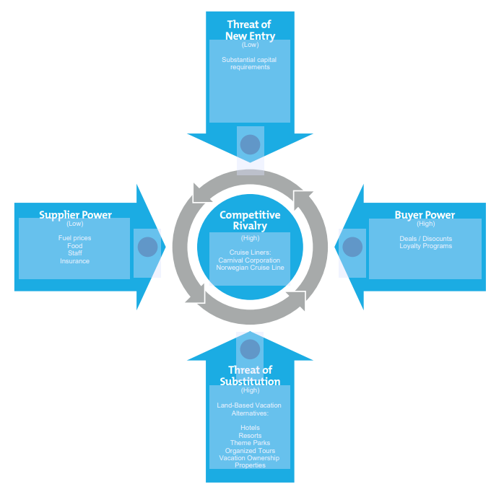
Appendix - 4 (Porter’s Five Forces )

Slide 23
Appendix - 4 (Value Chain )

Slide 24
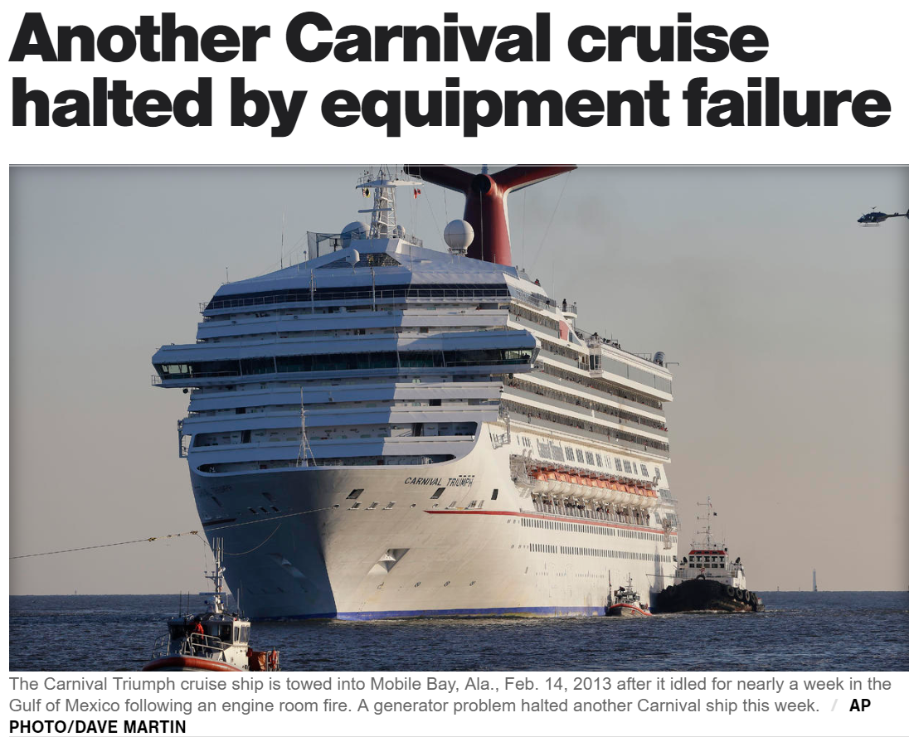
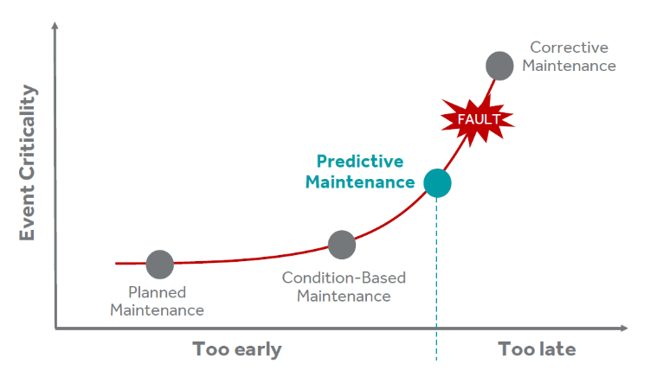
Predictive Maintenance Can Drastically Reduce Costs and Improve Customer Experience
Analytical Opportunity
Evaluation
Conclusion
Appendix
Driver Tree
Business Problem
Analytical Solution
Predict Remaining Useful Life (RUL) with regression
Impact
Increased passenger safety
Causes delays and discomfort
Negative press
Optimize the periodic maintenance operations
Major cost savings:
Reduces the frequency of maintenance
Minimizes the time spent maintaining equipment
Minimizes the cost of maintenance
Unplanned equipment failure
Install sensors on critical equipment to monitor data in real time
Lawsuits and declining sales
Notes:
The Carnival Triumph, with over 4,000 passengers aboard, idled for nearly a week in the Gulf of Mexico following an engine room fire and was being towed to port in Mobile, Ala. As passengers came within sight of land and a cellphone signal, a clearer picture of the scene aboard the ship began to emerge. They described overflowing toilets, sewage backed up in showers, scarce food, people getting sick and a tent city on what was supposed to be a tanning deck.

Slide 25
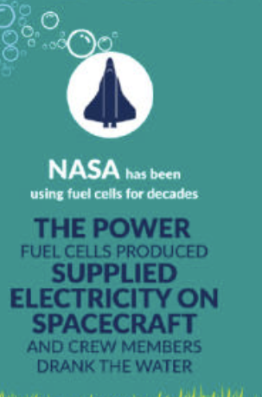
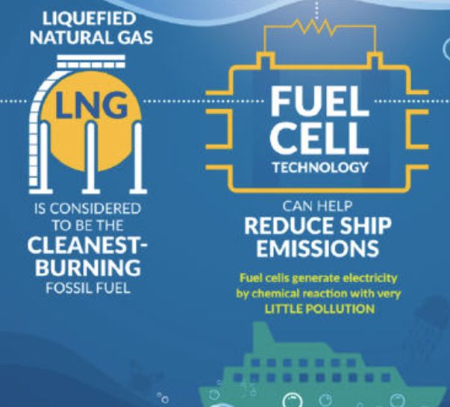
Energy Efficient Optimization modelling can Reduce Fuel Costs
Analytical Opportunity
Evaluation
Conclusion
Appendix
Driver Tree
Business Problem
The need for an innovative and energy efficient cruising technique binded with consumption optimization.
Analytical Solution
Predictive modelling to find a route based energy efficient cruising technique.
Impact
Clean fuel and simpler machinery means less machine maintenance. This in turn contributes to major cost saving by reducing the number of days in drydock.
Create optimization models to minimize the amount of energy use*
Balance between choice of energy to increase power and propulsion Vs energy saving waste reduction techniques.
Enables additional energy saving possibilities through efficient use and reuse of resources.
Route specific energy cruising technique would greatly lessen the cost spent on fuel.
Major factors taken into consideration are bunkering availability, location specific fuel cost, governmental initiatives* and ease of use.
http://publications.lib.chalmers.se/records/fulltext/234063/234063.pdf
Notes:
Government initiatives* - Singaporean government, for instance, has provided several promotions for LNG fueled ships such as exemption of port fee for 5 years and a 2 million Singapore dollars loan (Wong, 2017). The Korean Government has started to take similar initiatives as well.
Minimize energy use* - 1. Switching to LED (less power required without reducing brightness; less heat - saves energy for air-conditioning)
2. Shape of the propulsion system to maximize performance that would result in energy savings.
3. Waste cooking oil could be used as a lubrication for machinery, thereby reducing cost.

